Slide 1


Slide 2



Project on Analysis On Doctor Availability
By Vasundhara Chaitanya
&
Sravya Degala

Slide 3


Introduction
Patients often face difficulties in finding the right doctor or healthcare provider based on their specific needs, leading to a frustrating and time-consuming search process.
Lack of detailed information on doctor profiles, including experience, specialties, ratings, and reviews, making it difficult for patients to assess their suitability.
Inaccurate or incomplete information about the availability of doctors, leading to wasted time and effort in booking appointments that are not available.
Limited options for booking appointments, with some providers not offering online booking or requiring phone calls or in-person visits to schedule appointments.
Poor user experience and navigation on the website, leading to confusion
and difficulty in finding the desired information.

Slide 4


Problem statement:
Analysis On Doctor Availability:
Due to the COVID-19 pandemic, doctors are facing increased workloads and burnout, which leads to a shortage of healthcare providers and compromised patient care.

Slide 5








Libraries used
- Numerical Computations
For Data Manipulation and Analysis -
- Statistical Data Visualization
- Creating Data Visualization
Making HTTP requests -
Pattern matching & extract from text data -
- Parsing HTML and XML doc
- Handle Warnings during execution

Slide 6
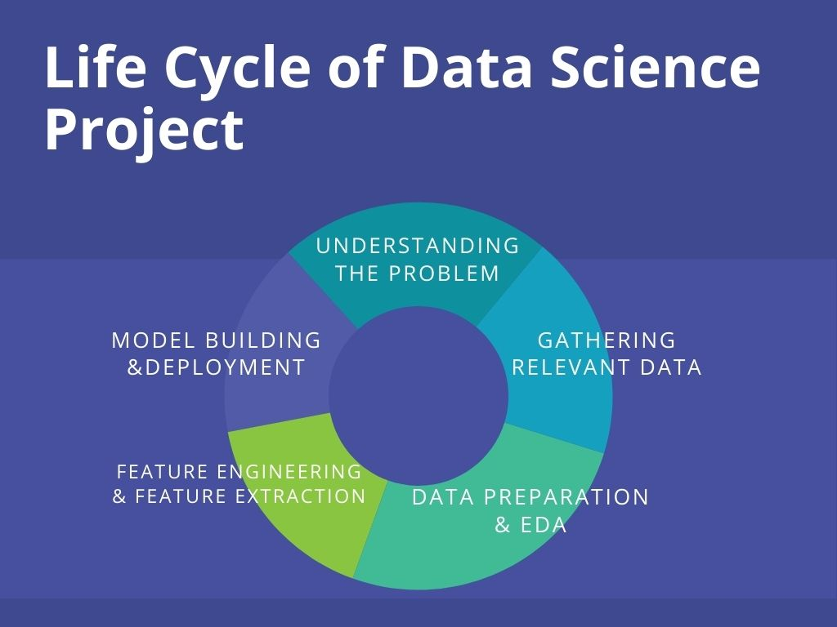
Doctor
Fee
Experience
City
Availability

Slide 7

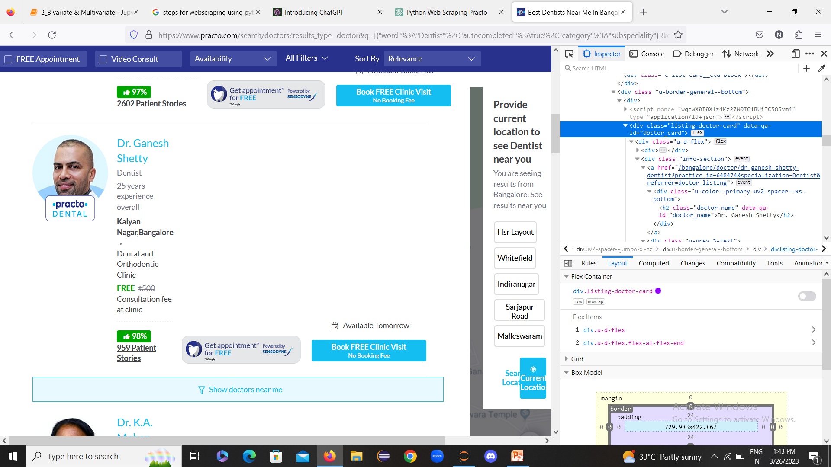




Data Collection
Step - 3
Step - 2
Send a request to the website
Parse the html code
Step - 4
Find the relevant information
Clean the data
Extract the information
Export the data

Slide 8
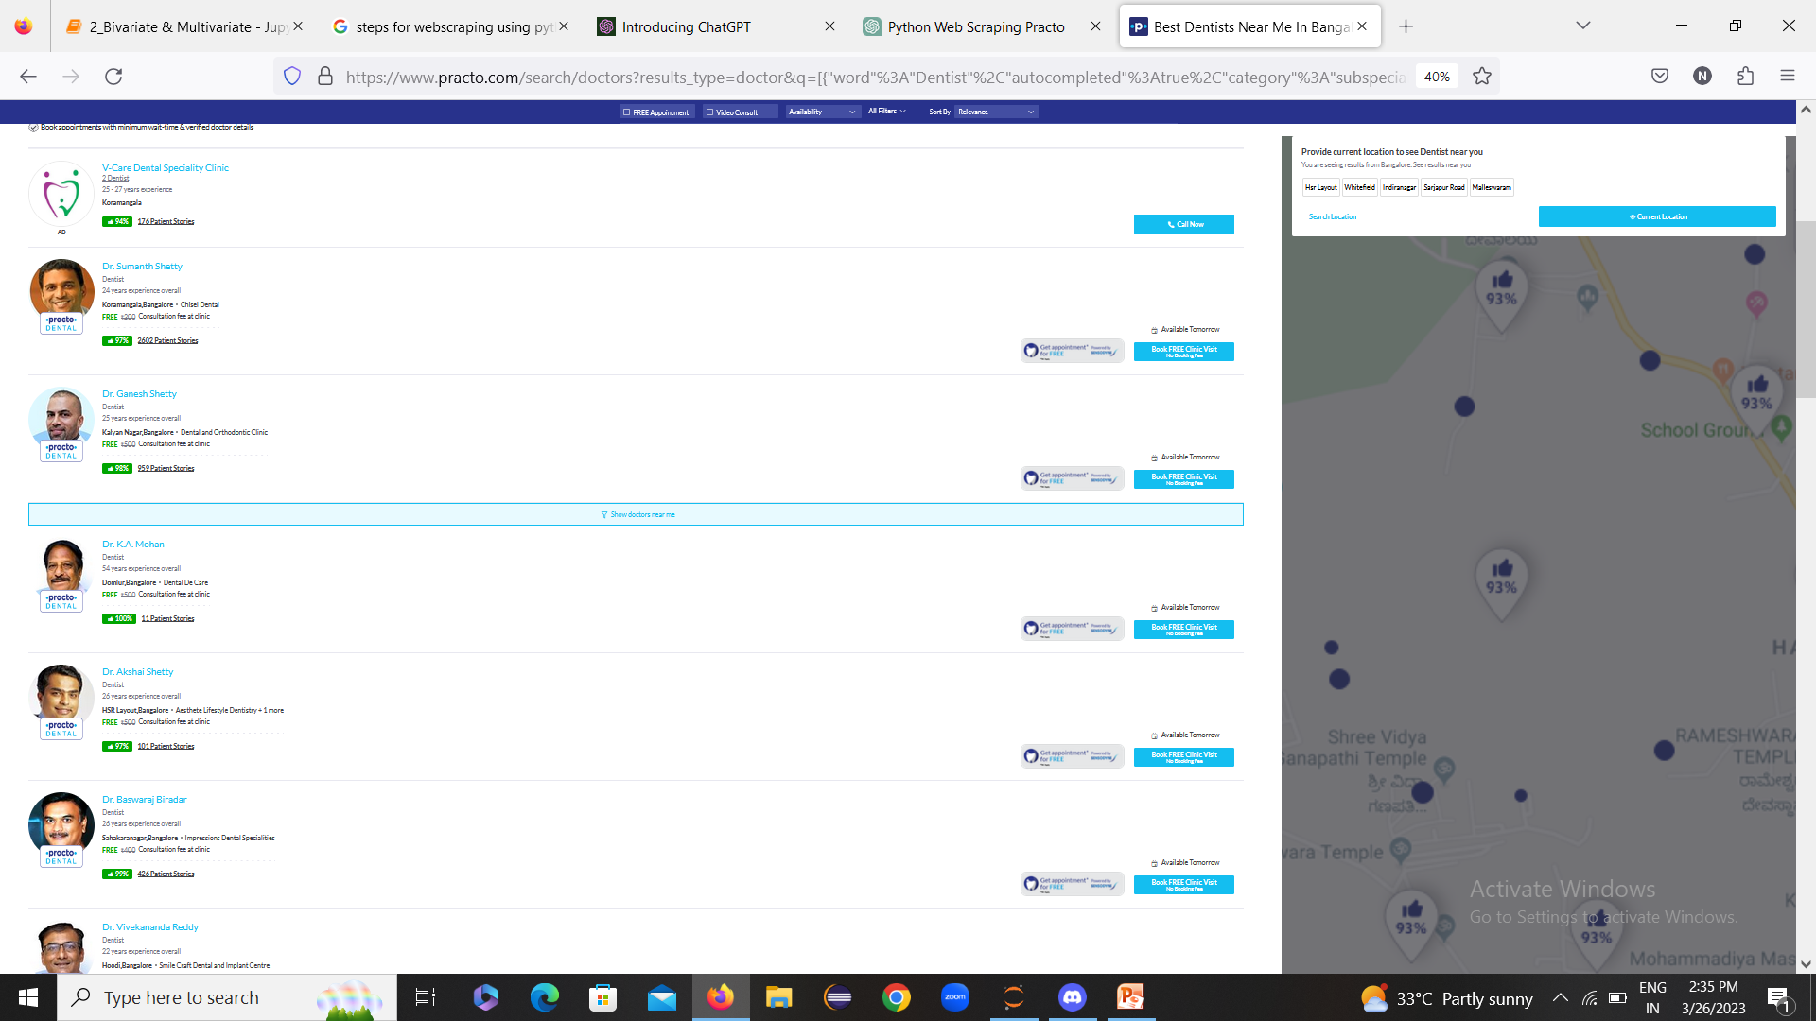
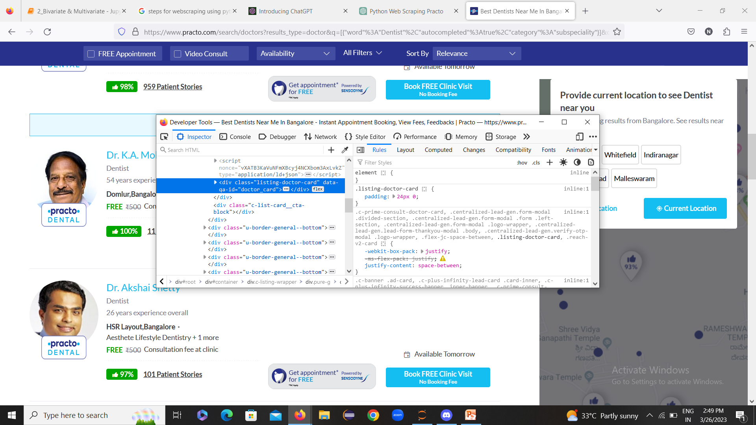
Web Scraping
Website : Practo.com
https://www.practo.com/doctors
Interface of the Website

Slide 9
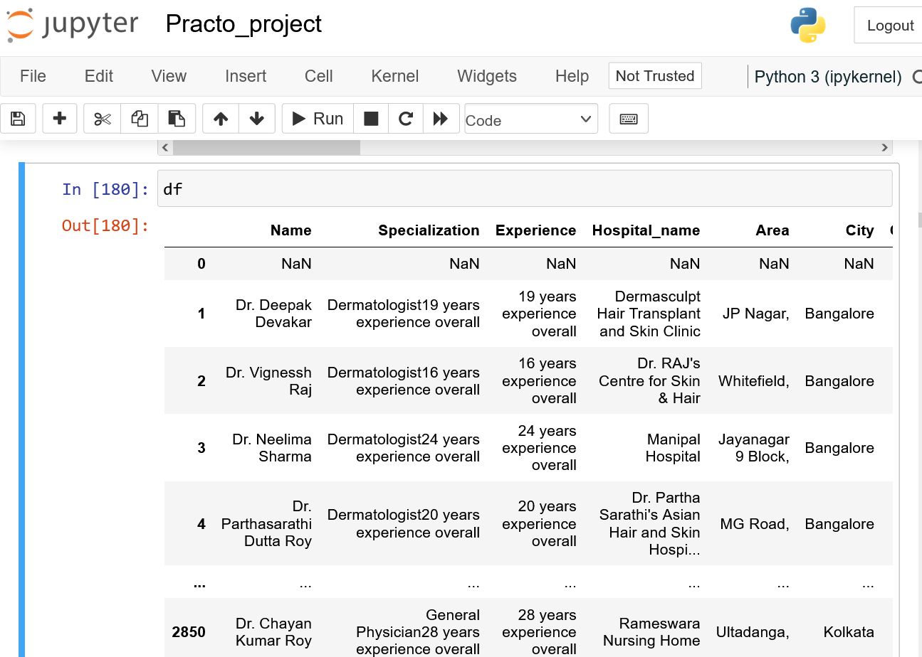
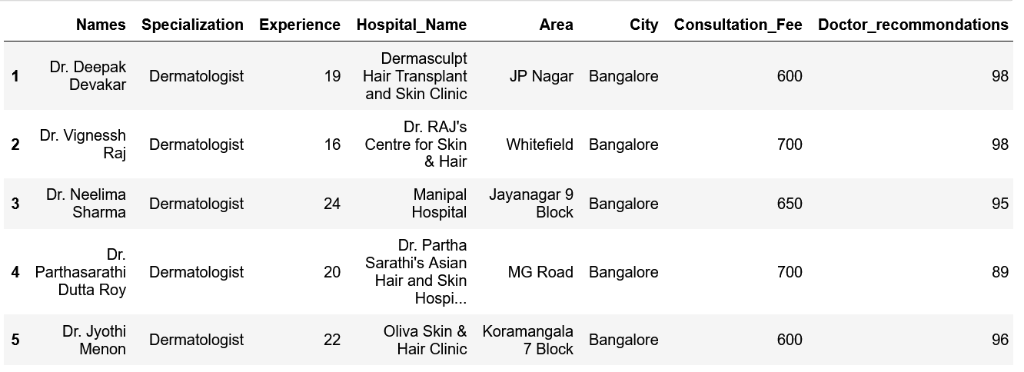
Raw Data:
CLEANED DATA

Slide 10
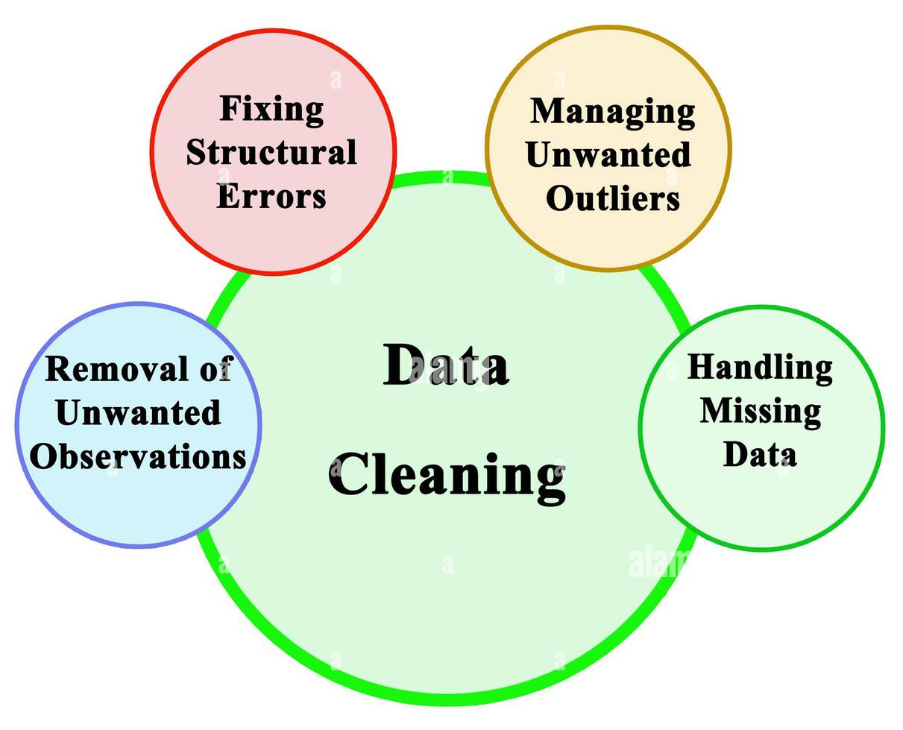
DATA CLEANING
It could involve several tasks, such as:
Removing duplicate or redundant entries from the database.
Correcting spelling mistakes, typos, or formatting errors in the data.
Standardizing data formats or values to ensure consistency across the database.
Removing incomplete or inconsistent data entries.
Checking the accuracy of the data and correcting any errors.
Verifying the authenticity of the data and removing any fraudulent entries.

Slide 11
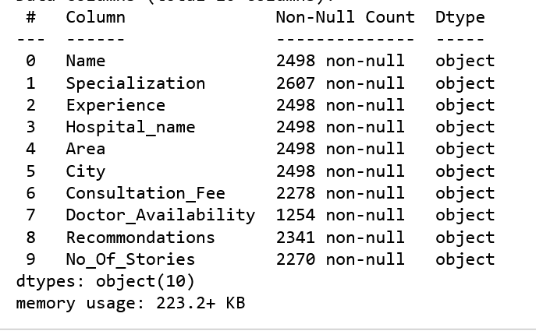



From the DataFrame:
Filling null values:
Dropping unwanted data:
Type Casting:

Slide 12

DATA ANALYSIS:
There are several types of data analysis, some of which are:
Descriptive analysis – Mean, Median, Mode, Standard Deviation, Frequency distribution.
Exploratory analysis – Scatter plots, Histogram, Boxplots, Heatmaps.
Inferential analysis – Hypothesis testing, Confinence intervals, Regression analysis.
Prescriptive analysis –Optimaization, Simulation and Decision Analysis.
Predictive analysis – Regression Analysis, Decision trees and Neural networks.
Diagnostic analysis – Root cause analysis, Hypothesis testing and Statistical process control.
Univariate
Bivariate
Multivariate
Exploratory Analysis

Slide 13
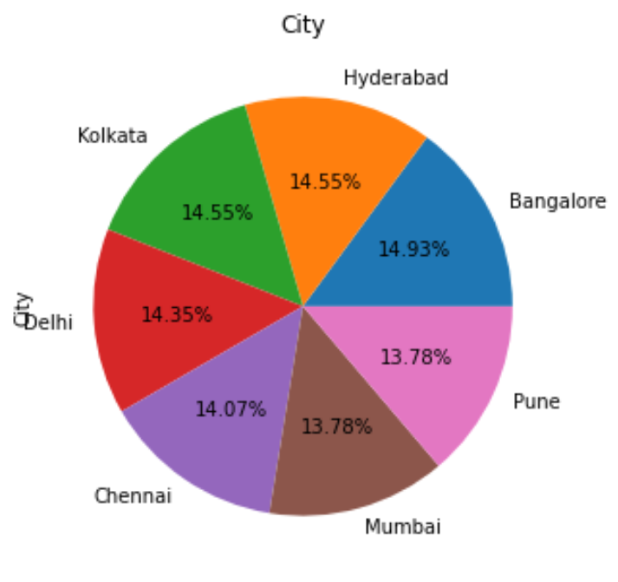
Percentage of Cities with Respect to Doctors
Most of the Doctors are in Bangalore with :14.93% and tops in the Doctors List.
Doctors in Kolkata and Hyderabad are in the takes the second highest with : 24.9%.
Doctors in Mumbai and Pune are in the least number with:13.78%.

Slide 14
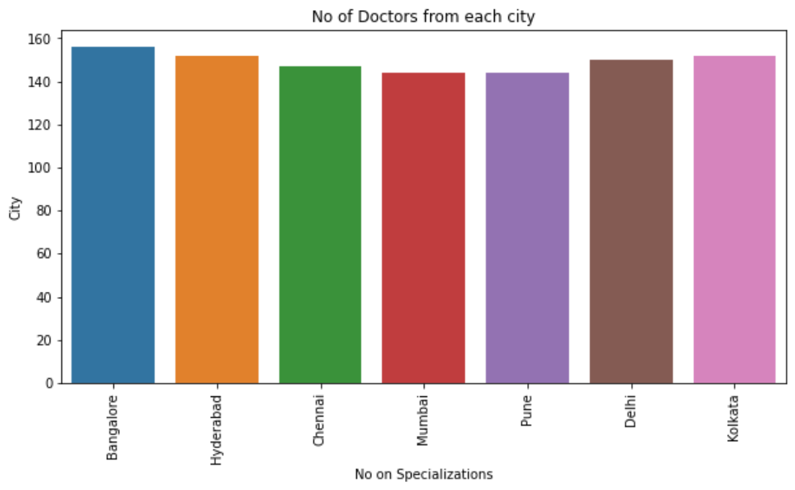
No of Doctors in each city
As per Plot, It is clear that no city is without Doctor.
And Bangalore city has More no of doctors i.e.., approximately 158 Doctors.
No Of Doctors
Cities

Slide 15
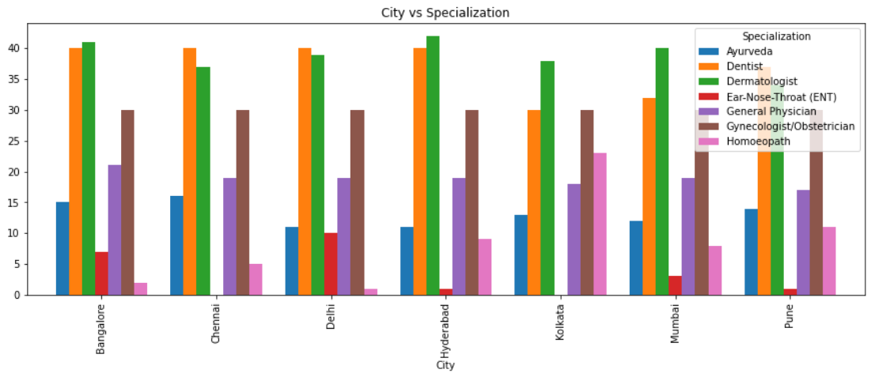
Count of Doctors in cities with respect to Specialization
We can conclude that,In most of the cities Dermatologists are more in number. followed by Dentists , Gynecologists , General Physician , Ayurveda , Homeopath and
ENT are in least no of Doctors in most of the cities .

Slide 16
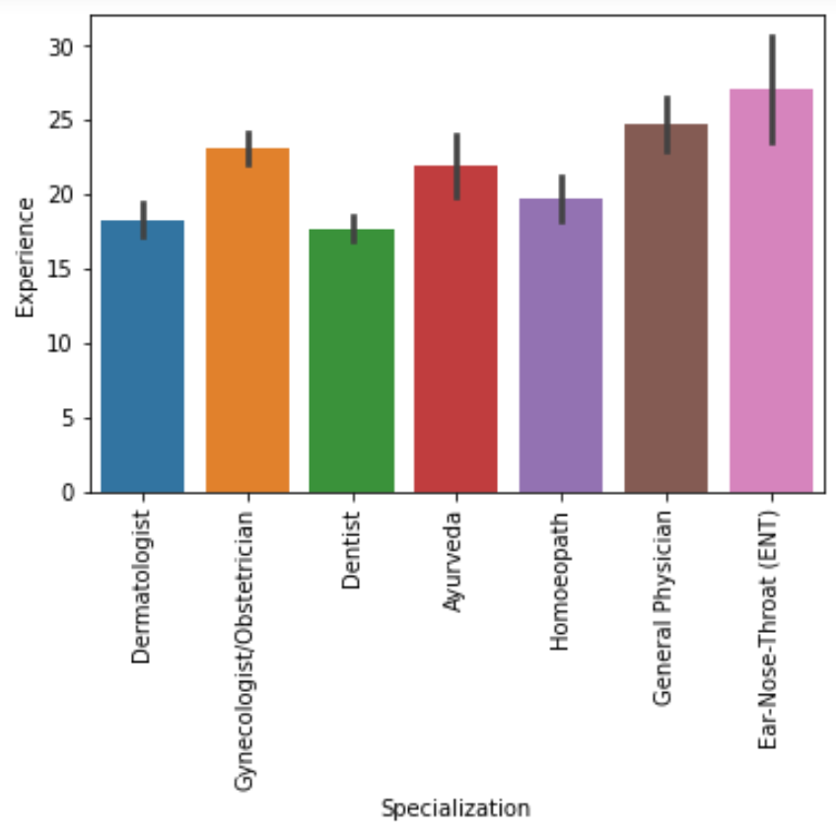
Specialization Vs Experience
Finding Specialists having highest Experience.
When we relate Specialization with Experience
ENT Specialists has maximum experience than any other Specialists.
Second highest Experience is for General Physician.

Slide 17
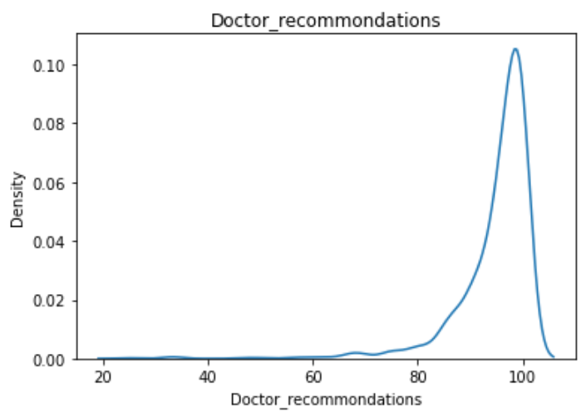
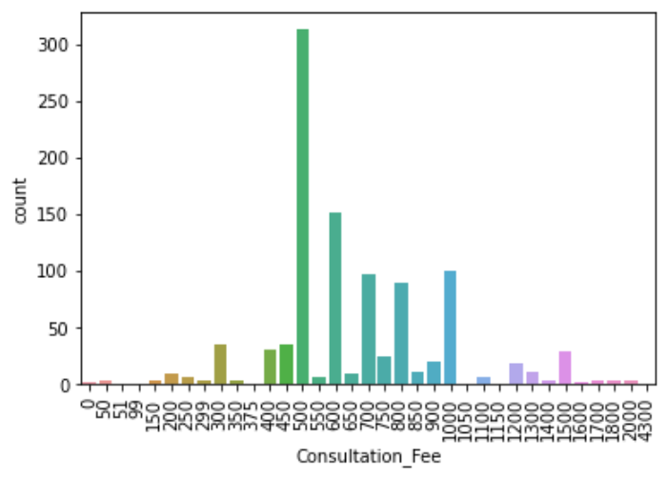
Maximum Consultation_Fee and Maximum Success_rate
As per the plot,It is clear that most of the Doctors Sucess_rate is 100%
As per the plot No of subscribes
Are more in
Music
Education
Entertainment
As per no of views
Music
Education
Shows
These three category makes on Top
As per the plot,Most of
the Doctors consultation fee is same i.e…, ₹500/-

Slide 18
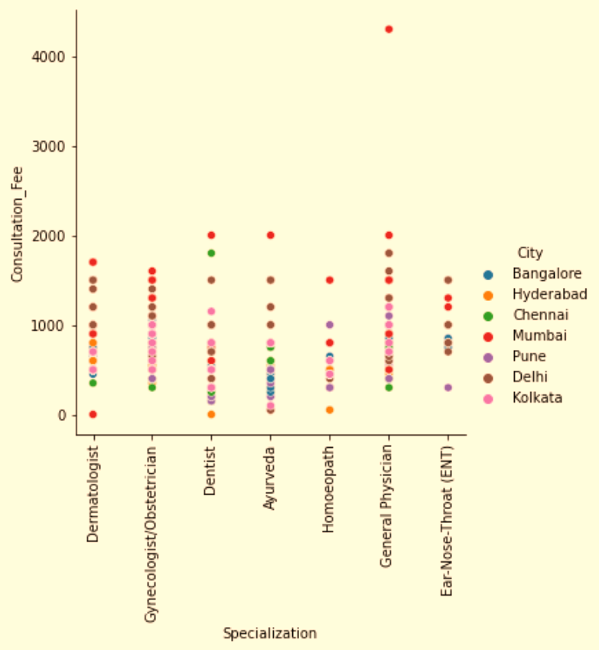
Variations of Consultation fee in each city with respect doctors
As we relational plot,We can clearly conclude that,
In Mumbai,General physician has more Consultation Fee.
And also in the same city,Dermatologist has 0 Consultation fee.

Slide 19
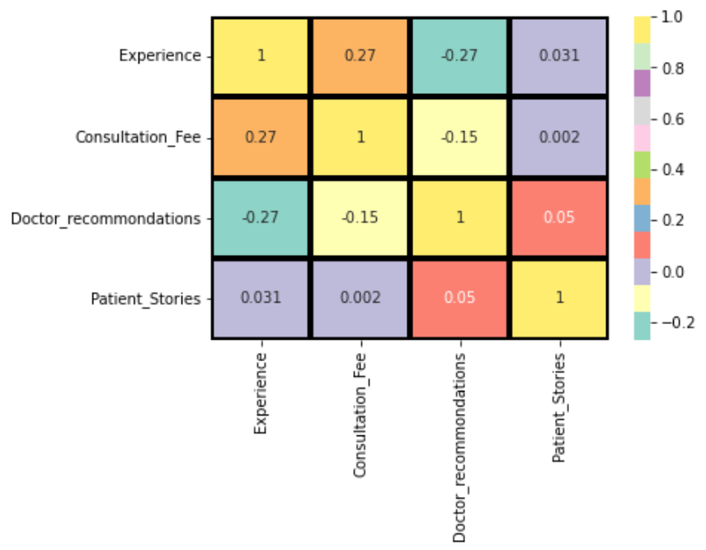
Correlation over 2-dimensional area
is a graphical representation of data in which values are represented as colors.
It is commonly used to display the distribution and intensity of data over a two-dimensional area or grid.
By this heatmap,it is clear that the correlation between Consultation fee and Experience is more than others.

Slide 20
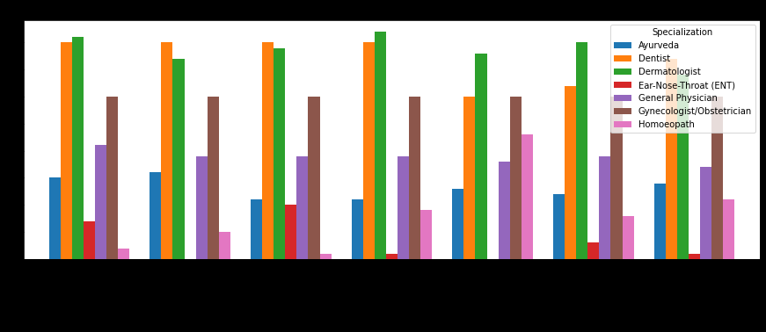



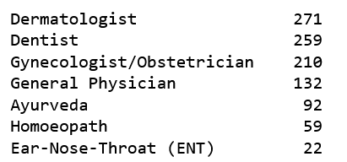
Expert Roundup
Q: How can I know which specialists are In Hyderabad?
A:
Q: Which Specialist in Hyderabad has least Consultation_Fee?
A :
Q: which Doctors are Available today itself?
A: All the Doctors of all Specializations are available today.
Q: How can I get clear view about no of doctors according to their Specialization?
A:
Q: What kind of information I can find about a doctor ?
A:Education, Experience, Specialization, Fee, Success_rate, Availabilty to help you make an informed choice.
Q: Does Experience effects Consultation_Fee?
A: Yes, it is positively correlated.

Slide 21

Challenges Faced:
Dynamic content: Practo's website uses dynamic content that loads dynamically as the user scrolls down the page. This can make it challenging to scrape all the relevant information.
Data structure changes: Practo's website may make changes to its data structure or HTML/CSS code, which can break existing web scraping scripts and require frequent updates.
Privacy concerns: Practo.com may involve scraping personal information about doctors and patients, which raises privacy concerns and may be illegal in some jurisdictions.
Incomplete Data: As the format of the website is different in some pages,required data will not scrap from the website.So,it leads to inconsistent data. And this makes challenging to fill all that data.

Slide 22

CONCLUSION:
Practo.com was Founded in 2008,
Includes over 200,000 doctors,
10,000 hospitals, and
20,000 diagnostic centers across India.
is a dynamic and innovative healthcare
As implied by the various parameters as,
Location
Specialization
Experience
Consultation_Fee
Success_rate
Reviews
Doctor Availability

Slide 23


